Slide 1
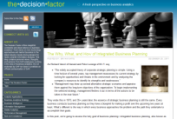

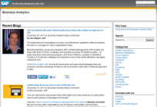

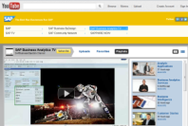

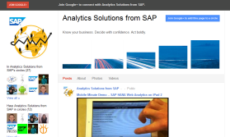
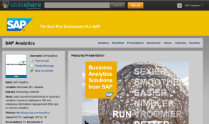
Business Analytics Social Media Channels
Net New
  The Decision Factor Blog
    Targeted at net-new customers and designed specifically to focus on business analytics thought leadership, with no mention of SAP or SAP products
    One of two main thought leadership channels (with Business Analytics blog), all posts feed into other channels
  @DecisionFactor Twitter Handle
    Companion Twitter handle to The Decision Factor
    Information and awareness channel and key promotional tool for non-SAP thought leadership
  Business Analytics Blog
    Targeted at SAP customer base and heavily promotes SAP solutions
    One of two main thought leadership channels (with The Decision Factor blog), all posts feed into other channels
  @businessobjects Twitter Handle
    Information and awareness channel and key promotional tool for campaigns, heavily promotes SAP solutions
  SAP Business Analytics TV - YouTube Channel
    A key channel with multiple playlists to cover all of business analytics
    Taps the ever-growing interest in videos and YouTube’s high-ranking Google juice
  Business Analytics Facebook Fan Page
    Provides more opportunities for engagement and promotes different key topics
  NEW
    Google+
    Slideshare
Installed Base

